Slide 1

Resource Guide
January 2nd, 2026

Slide 2







Grainger Dedicated
Business Development Manager Open | Business Development Director Mary McGill Mmcgill@justrite.com 864-584-2853
Resource List
Brand Support
 | West Coast – Notrax / Sales Engineer Steve Harris sharris@notrax.com 503-880-4037 | East - Coast – Notrax / Sales Engineer Thomas Nguyen tnguyen@notrax.com
 | Notrax / Inside Sales Specialist Julie Nowakowski jnowakowski@notrax.com 815-354-9631
 | Justrite - Eagle /Sales Engineer open | Justrite – Eagle / Sales Engineer David Nazaire dnazaire@justrite.com 847-347-1224
 | Accuform / Natl Accounts Director OPEN | Accuform / Natl Acct Specialist -East Erin Kent ekent@accuformnmc.com 352-584-3595
 | East Coast Checkers / Sales Engineer Brooke Smith bsmith@justrite.com 814-758-7694 | West Coast Checkers / Sales Engineer Heather Stone hstone@checkers-safety.com
 | Sales Engineer – Standard Solutions Jeff Morris jmorris@uschemicalstorage.com 919-909-7929 | Sales Engineer – Engineered Buildings Jason Faughtenberry jfaughtenberry@uschemicalstorage.com 919-526-8313

Slide 3
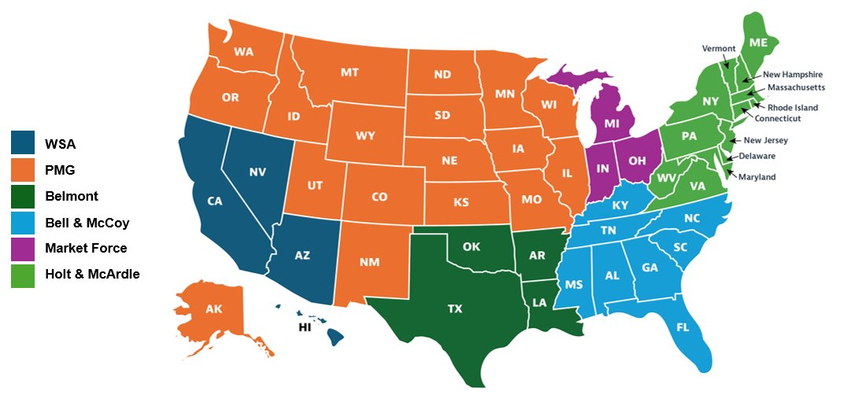
Supporting Manufacture Rep Agencies
Safety, Industrial, and Construction Focused Independent Manufacturer Representative Agencies​
WSA​ | PMG​ | Belmont​ | Bell & McCoy​ | Market Force​ | Holt & McArdle​
Western Safety Associates​ sales@wsarep.com​ 951-371-8685 ​ | PMG Safety​ sales@pmgmidwest.com​ 314-614-1419​ | Belmont Entreprises info@bereps.com​ 713-673-4000​ | Bell & McCoy​ tnasoni@bellandmccoy.com​ 786-801-9958​ | Market Force, Inc. info@marketforceinc.net​ 1-800-622-6808​ | Holt & McArdle Associates assoc@holtmcardle.com​ 610-497-1766​
Aligned Customer Service​ Megan Cassiday​ mcassiday@justrite.com​ 217-238-5214​ | Aligned Customer Service​ Megan Cassiday mcassiday@justrite.com​ 217-238-5214​ | Aligned Customer Service​ Megan Cassiday​ mcassiday@justrite.com​ 217-238-5214​ | Aligned Customer Service​ Kelly Slivka kslivka@justrite.com​ 217-238-5132​ | Aligned Customer Service​ Kelly Slivka kslivka@justrite.com​ 217-238-5132​ | Aligned Customer Service​ Kelly Slivka kslivka@justrite.com​ 217-238-5132

Slide 4

Rep Agency Contacts

Slide 5
Rep Agency Contacts

Slide 6
Rep Agency Contacts

Slide 7
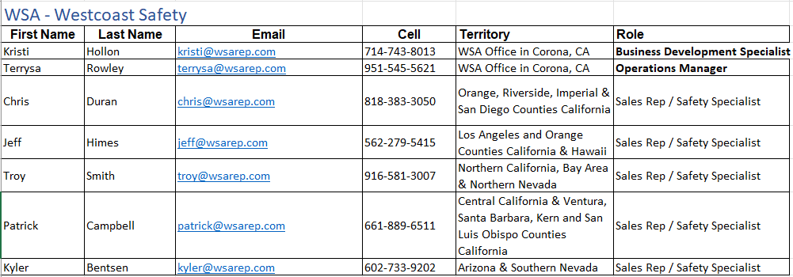
Rep Agency Contacts

Slide 8
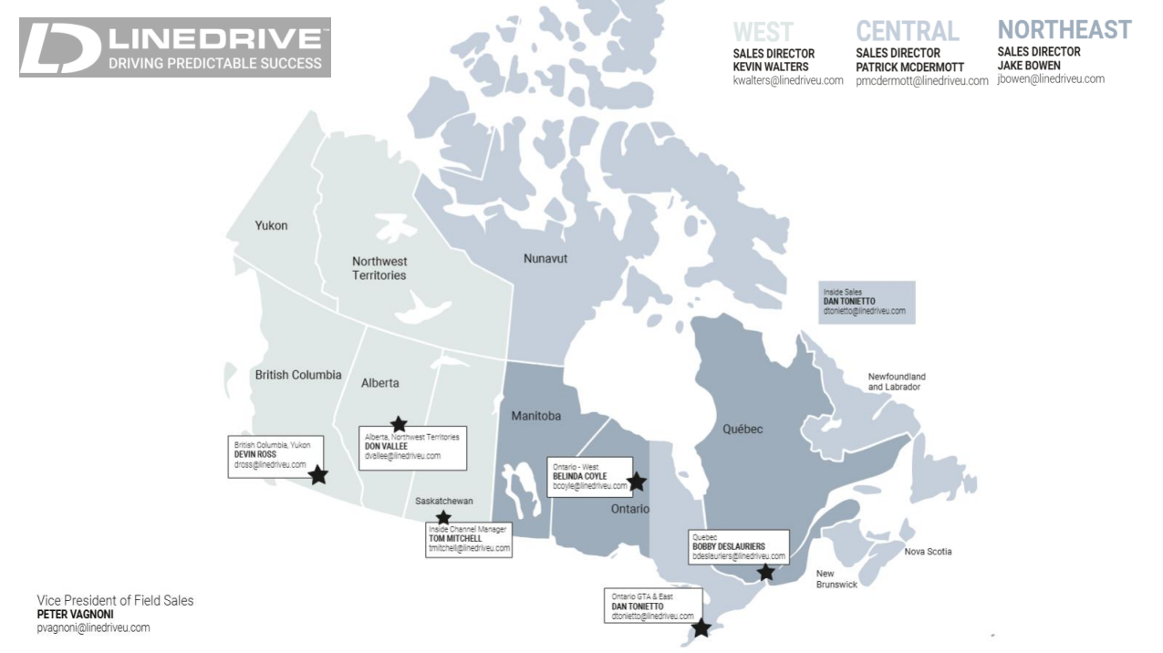
Rep Agency Contacts

